Slide 1
JavaScript: Client-Side Scripting
Chapter 6

Slide 2
Objectives
1
2
What is JavaScript
JavaScript Design
3
4
Using
JavaScript
Syntax
5
6
JavaScript
Objects
The DOM
7
7
JavaScript
Events
8
Forms

Slide 3
Document Object
One root to ground them all
The DOM document object is the root JavaScript object representing the entire HTML document.
It contains some properties and methods that we will use extensively in our development and is globally accessible as document.
// specify the doctype, for example html
var a = document.doctype.name;
// specify the page encoding, for example ISO-8859-1
var b = document.inputEncoding;

Slide 4
Document Object
Document Object Methods
Method | Description
createAttribute() | Creates an attribute node
createElement() | Creates an element node
createTextNode() | Create a text node
getElementById(id) | Returns the element node whose id attribute matches the passed id parameter.
getElementsByTagName(name) | Returns a nodeList of elements whose tag name matches the passed name parameter.

Slide 5
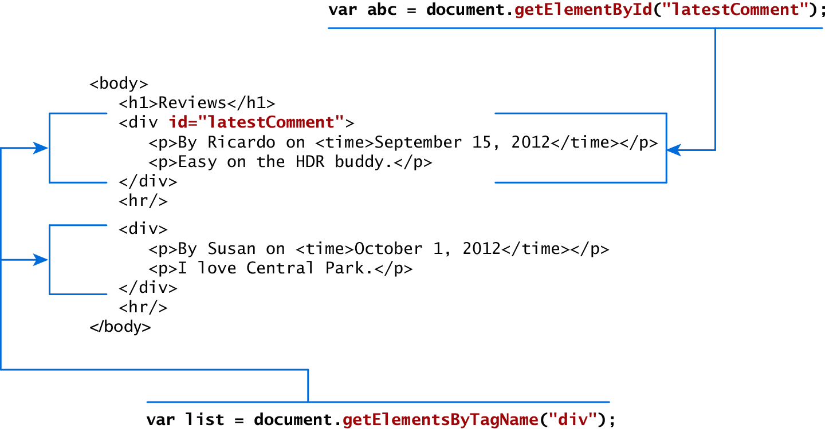
Accessing nodes
getElementById(), getElementsByTagName()

Slide 6
Element node Object
document.getElementById() returns an element node object.
This represents an HTML element in the hierarchy, contained between the opening <> and closing </> tags for this element.
can itself contain more elements

Slide 7
Element node Object
Essential Element Node Properties
Property | Description
className | The current value for the class attribute of this HTML element.
id | The current value for the id of this element.
innerHTML | Represents all the things inside of the tags. This can be read or written to and is the primary way which we update particular div's using JS.
style | The style attribute of an element. We can read and modify this property.
tagName | The tag name for the element.

Slide 8
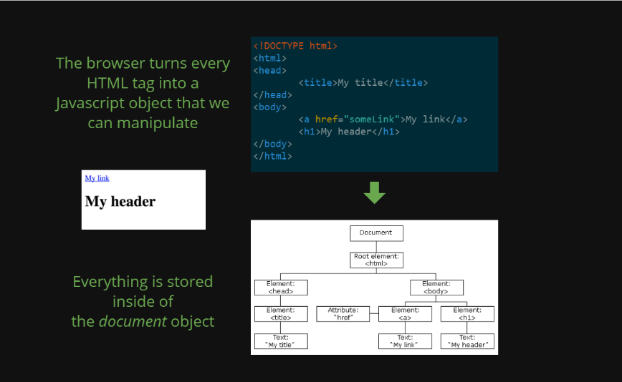
Exercise

Slide 9
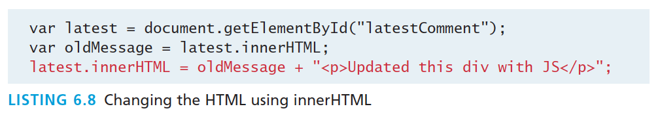
Modifying a DOM element
The document.write() method is used to create output to the HTML page from JavaScript.
Using the DOM document and HTML DOM element objects, we can do exactly that using the innerHTML property

Slide 10
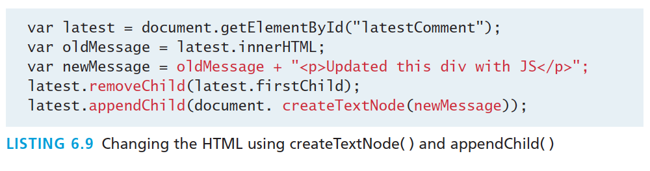
Modifying a DOM element
DOM functions createTextNode(), removeChild(), and appendChild() allow us to modify an .

Slide 11
Changing an element’s style
We can add or remove any style using the style or className property of the Element node.
Its usage is shown below to change a node’s background color and add a three-pixel border.
var commentTag = document.getElementById("specificTag");
commentTag.style.backgroundColour = "#FFFF00";
commentTag.style.borderWidth="3px";

Slide 12
Changing an element’s style
With class
The className property is normally a better choice, because it allows the styles to be created outside the code, and thus be better accessible to designers.
var commentTag = document.getElementById("specificTag");
commentTag.className = "someClassName";
HTML5 introduces the classList element, which allows you to add, remove, or toggle a CSS class on an element.
label.classList.addClass("someClassName");

Slide 13
More Properties
Some Specific HTML DOM Element Properties for Certain Tag Types
Property | Description | Tags
href | The href attribute used in a tags to specify a URL to link to. | a
name | The name property is a bookmark to identify this tag. Unlike id which is available to all tags, name is limited to certain form related tags. | a, input, textarea, form
src | Links to an external URL that should be loaded into the page (as opposed to href which is a link to follow when clicked) | img, input, iframe, script
value | The value is related tot he value attribute of input tags. Often the value of an input field is user defined, and we use value to get that user input. | Input, textarea, submit

Slide 14
JavaScript Events
Section 7 of 8

Slide 15
JavaScript Events
A JavaScript event is an action that can be detected by JavaScript.
We say then that an event is triggered and then it can be caught by JavaScript functions, which then do something in response.

Slide 16
JavaScript Events
A brave new world
In the original JavaScript world, events could be specified right in the HTML markup with hooks to the JavaScript code (and still can).
As more powerful frameworks were developed, and website design and best practices were refined, this original mechanism was supplanted by the listener approach.

Slide 17
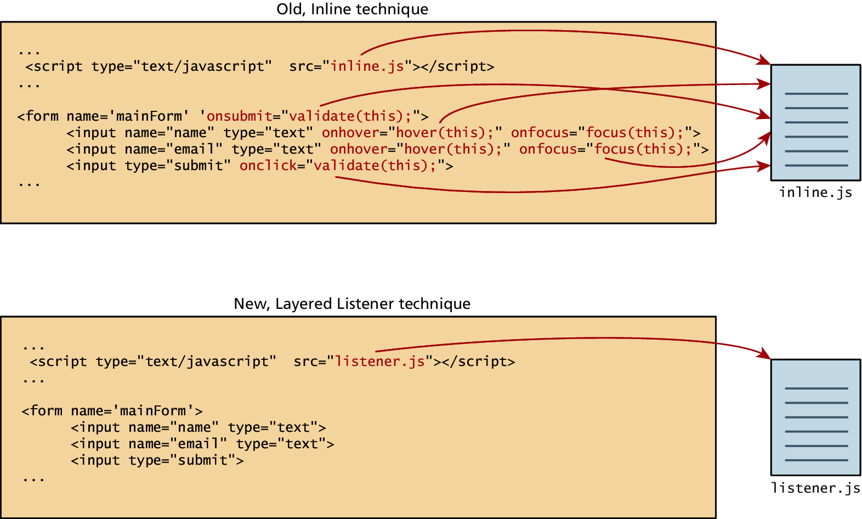
JavaScript Events
Two approaches

Slide 18
Inline Event Handler Approach
For example, if you wanted an alert to pop-up when clicking a <div> you might program:
<div id="example1" onclick="alert('hello')">Click for pop-up</div>

Slide 19
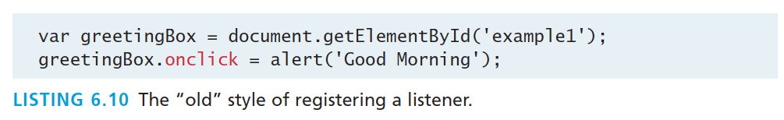
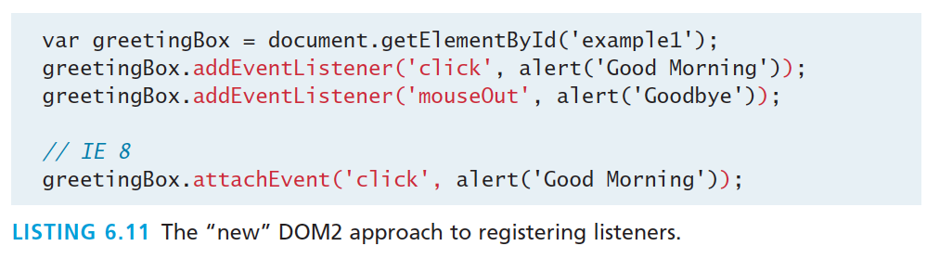
Listener Approach
Two ways to set up listeners

Slide 20
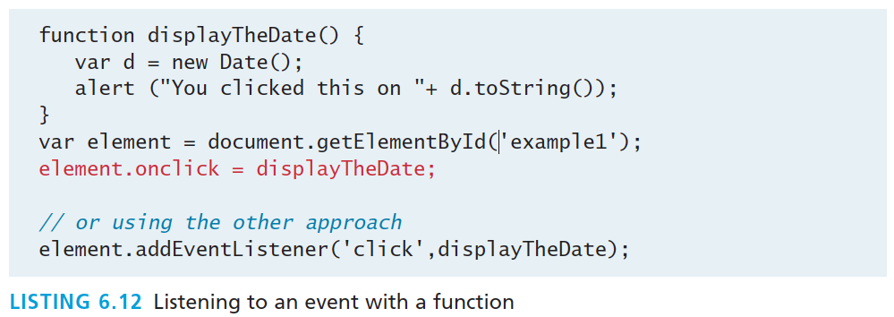
Listener Approach
Using functions

Slide 21
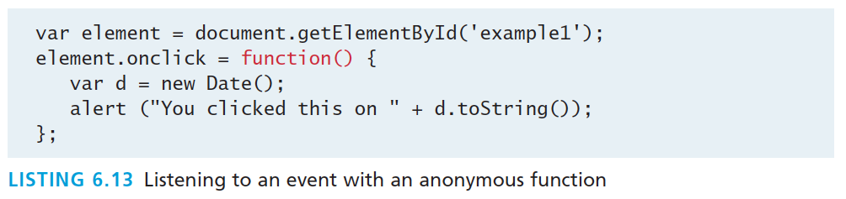
Listener Approach
Anonymous functions

Slide 22
Event Object
Handling an event
Typically we see the events passed to the function handler as a parameter named e.
function someHandler(e) {
// e is the event that triggered this handler.
}

Slide 23
Event Object
Several Options
Bubbles. If an event’s bubbles property is set to true then there must be an event handler in place to handle the event or it will bubble up to its parent and trigger an event handler there.
Cancelable. The Cancelable property is also a Boolean value that indicates whether or not the event can be cancelled.
preventDefault. A cancelable default action for an event can be stopped using the preventDefault() method in the next slide

Slide 24
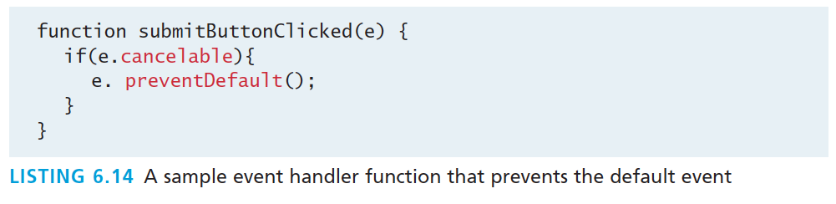
Event Object
Prevent the default behaviour

Slide 25
Event Types
There are several classes of event, with several types of event within each class specified by the W3C:
mouse events
keyboard events
form events
frame events

Slide 26
Mouse events
Event | Description
onclick | The mouse was clicked on an element
ondblclick | The mouse was double clicked on an element
onmousedown | The mouse was pressed down over an element
onmouseup | The mouse was released over an element
onmouseover | The mouse was moved (not clicked) over an element
onmouseout | The mouse was moved off of an element
onmousemove | The mouse was moved while over an element

Slide 27
Keyboard events
Event | Description
onkeydown | The user is pressing a key (this happens first)
onkeypress | The user presses a key (this happens after onkeydown)
onkeyup | The user releases a key that was down (this happens last)

Slide 28
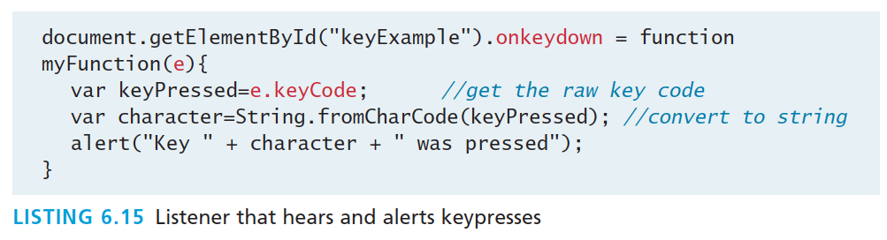
Keyboard events
Example
<input type="text" id="keyExample">
The input box above, for example, could be listened to and each key pressed echoed back to the user as an alert as shown in Listing 6.15.

Slide 29
Form Events
Event | Description
onblur | A form element has lost focus (that is, control has moved to a different element, perhaps due to a click or Tab key press.
onchange | Some <input>, <textarea> or <select> field had their value change. This could mean the user typed something, or selected a new choice.
onfocus | Complementing the onblur event, this is triggered when an element gets focus (the user clicks in the field or tabs to it)
onreset | HTML forms have the ability to be reset. This event is triggered when that happens.
onselect | When the users selects some text. This is often used to try and prevent copy/paste.
onsubmit | When the form is submitted this event is triggered. We can do some pre-validation when the user submits the form in JavaScript before sending the data on to the server.

Slide 30
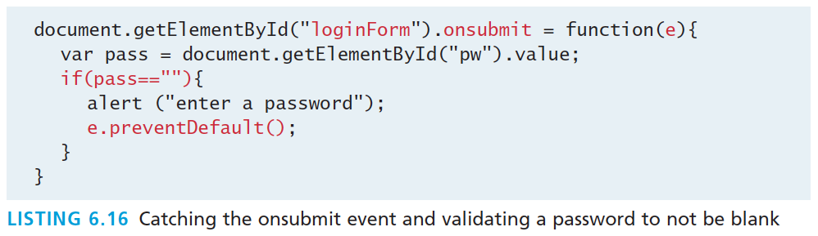
Form Events
Example

Slide 31
Frame Events
Frame events are the events related to the browser frame that contains your web page.
The most important event is the onload event, which tells us an object is loaded and therefore ready to work with. If the code attempts to set up a listener on this not-yet-loaded <div>, then an error will be triggered.
window.onload= function(){
//all JavaScript initialization here.
}

Slide 32
Frame Events
Table of frame events
Event | Description
onabort | An object was stopped from loading
onerror | An object or image did not properly load
onload | When a document or object has been loaded
onresize | The document view was resized
onscroll | The document view was scrolled
onunload | The document has unloaded

Slide 33
Forms
Section 8 of 8

Slide 34
Validating Forms
You mean pre-validating right?
Writing code to prevalidate forms on the client side will reduce the number of incorrect submissions, thereby reducing server load.
There are a number of common validation activities including email validation, number validation, and data validation.

Slide 35
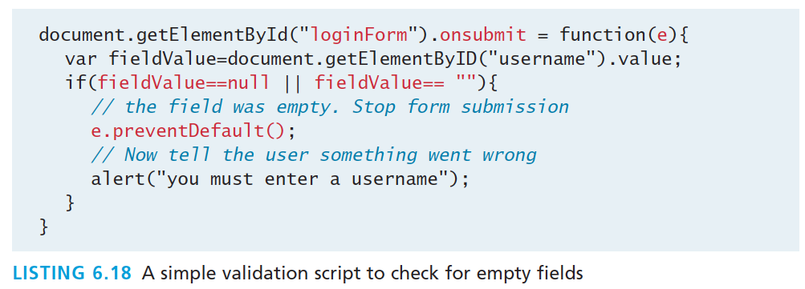
Validating Forms
Empty field

Slide 36
Validating Forms
Empty field
If you want to ensure a checkbox is ticked, use code like that below.
var inputField=document.getElementByID("license");
if (inputField.type=="checkbox"){
if (inputField.checked)
//Now we know the box is checked
}

Slide 37
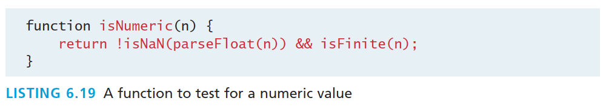
Validating Forms
Number Validation

Slide 38
Submitting Forms
Submitting a form using JavaScript requires having a node variable for the form element. Once the variable, say, formExample is acquired, one can simply call the submit() method:
var formExample = document.getElementById("loginForm");
formExample.submit();
This is often done in conjunction with calling preventDefault() on the onsubmit event.

Slide 39
What you Learned
1
2
What is JavaScript
JavaScript Design
3
4
Using
JavaScript
Syntax
5
6
JavaScript
Objects
The DOM
7
7
JavaScript
Events
8
Forms

